Slide 1











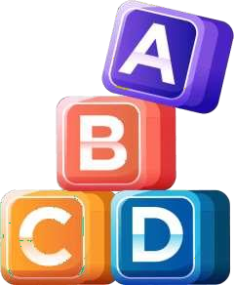






StudyTrack
“Track, Improve, Achieve”

Slide 2









Abstract
The StudyTrack system is a web-based application designed to help students discover personalized study routines using behavioral data and machine learning. It allows students to log study behavior and receive customized recommendations to improve academic performance. The system includes an admin panel for managing datasets and retraining models, and securely stores user data. It is built using Python, MySQL, HTML, CSS, and JavaScript.

Slide 3
Introduction
01.
StudyTrack uses behavioral data and machine learning to recommend personalized study routines.
03. Dashboards and reports
provide insights into learning patterns and progress.
Mentors and admins monitor student effectiveness and update models with new behavioral data.
02. Students log study habits
and receive tailored suggestions to improve performance.
04.

Slide 4
Student Features
Register & login to access personalized dashboard
Log study habits, quiz results, and attention metrics
View tailored study routine suggestions based on behavioral patterns
Track academic improvement and feedback through dynamic reports and charts

Slide 5
Mentor Features
Monitor students study progress
Access detailed performance reports
Identify weak areas for improvement
Guide students with personalized feedback

Slide 6





System Overview
Tech Stack:
Frontend: HTML, CSS, JavaScript Backend: Python
Database: MySQL
Workflow:
Login → Registration → Dashboard → Add Tasks → Track Progress → Reports
01
02
03
Database Storage: All login, registration, dashboard, and validation data is securely stored

Slide 7








MILESTONES 1
User Authentication
Registration, login, and password reset with validation.
All user details stored securely in the database.
Database & Dashboard
Designed schema with Users, Subjects, Tasks, and Progress tables User-friendly dashboard to manage tasks, deadlines, and reminders

Slide 8






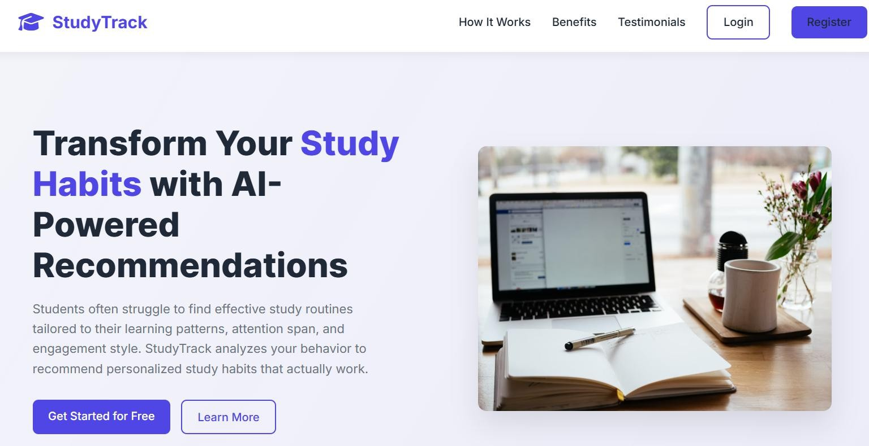
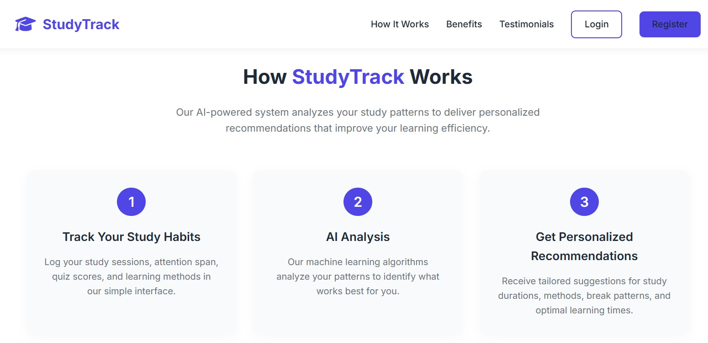

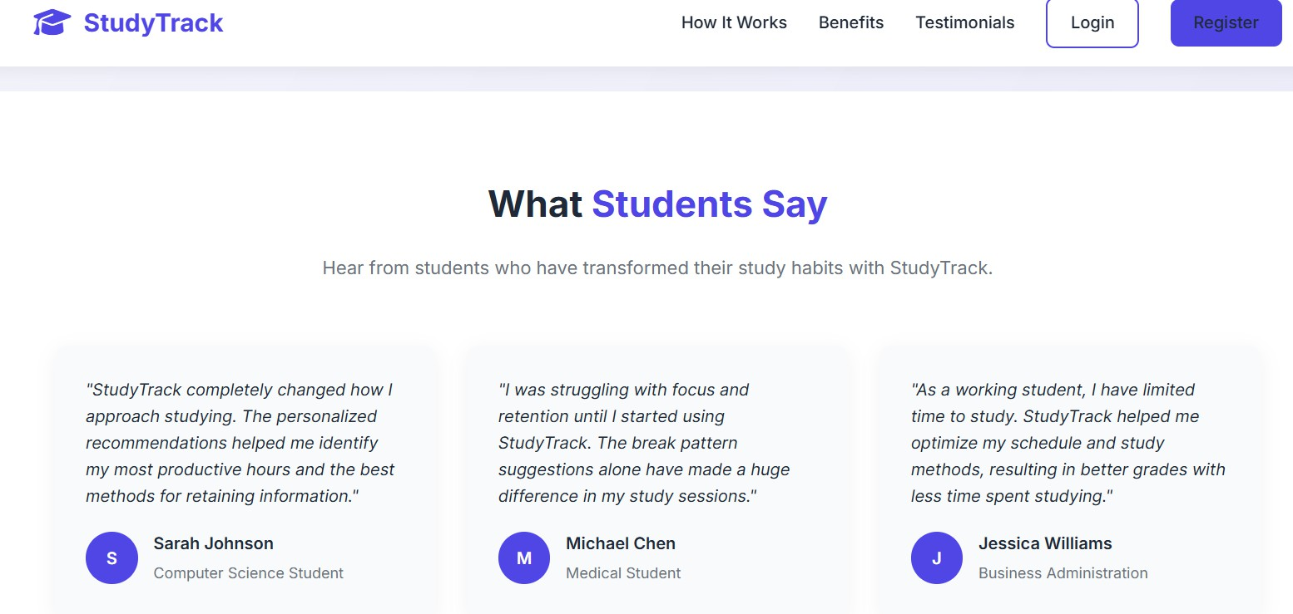




Home Page

Slide 9

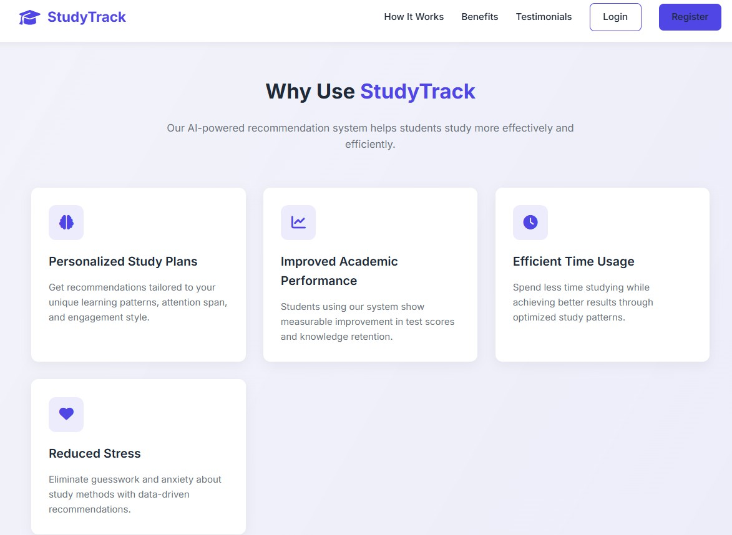

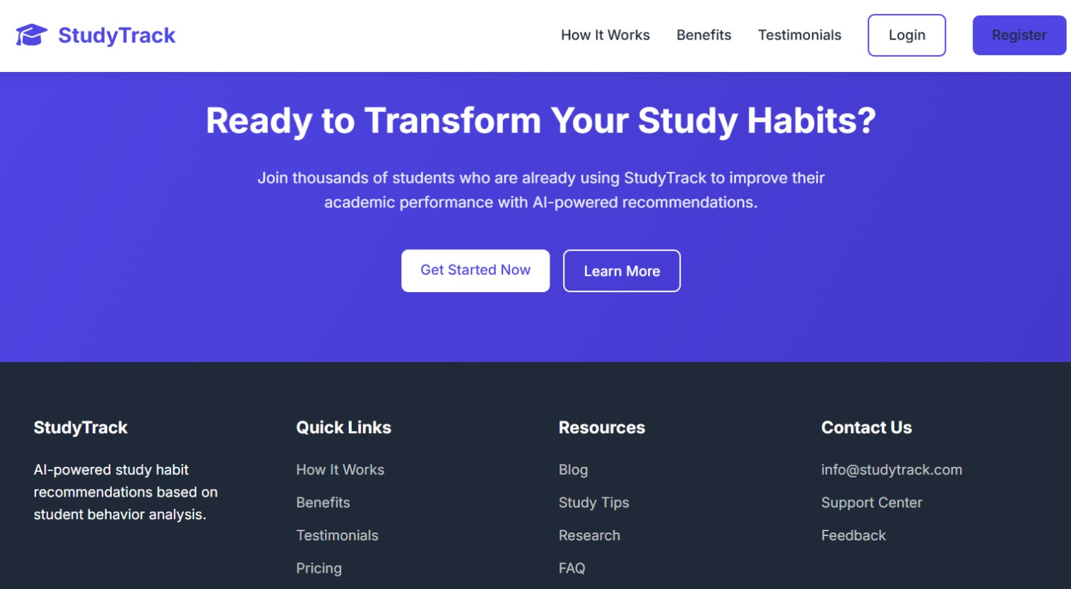
Home Page

Slide 10








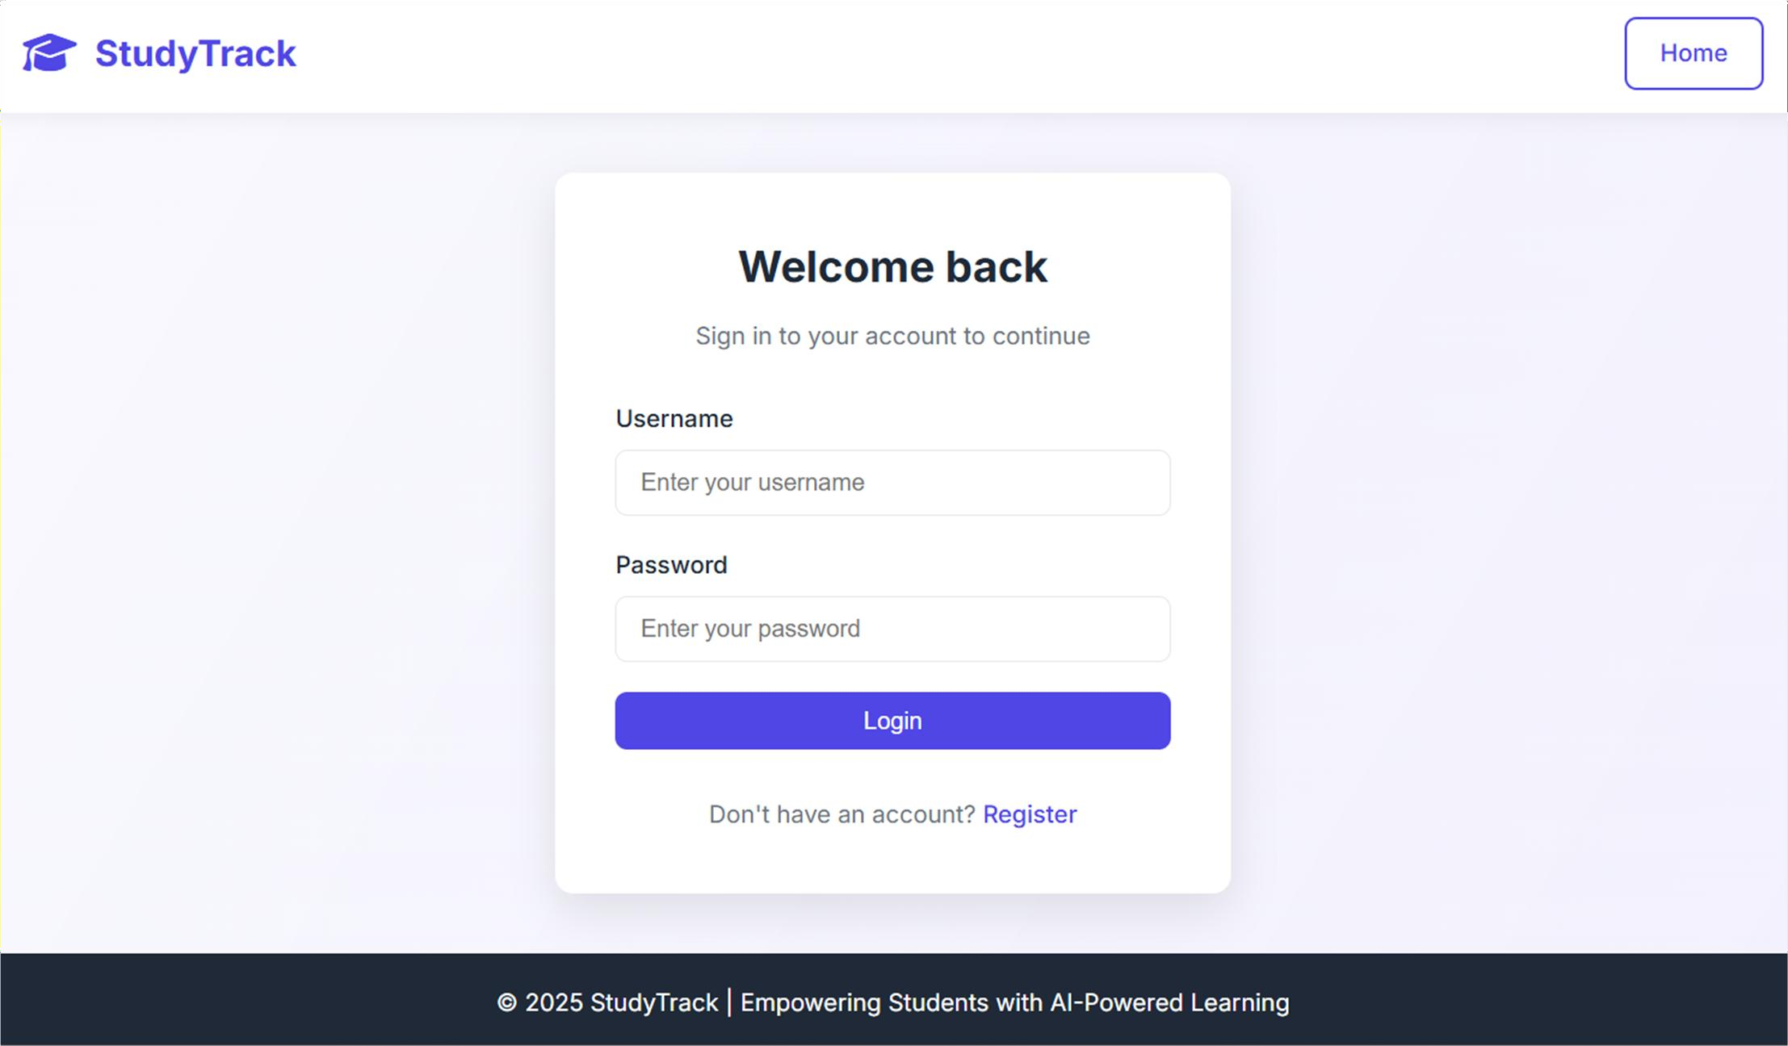






Login Page

Slide 11


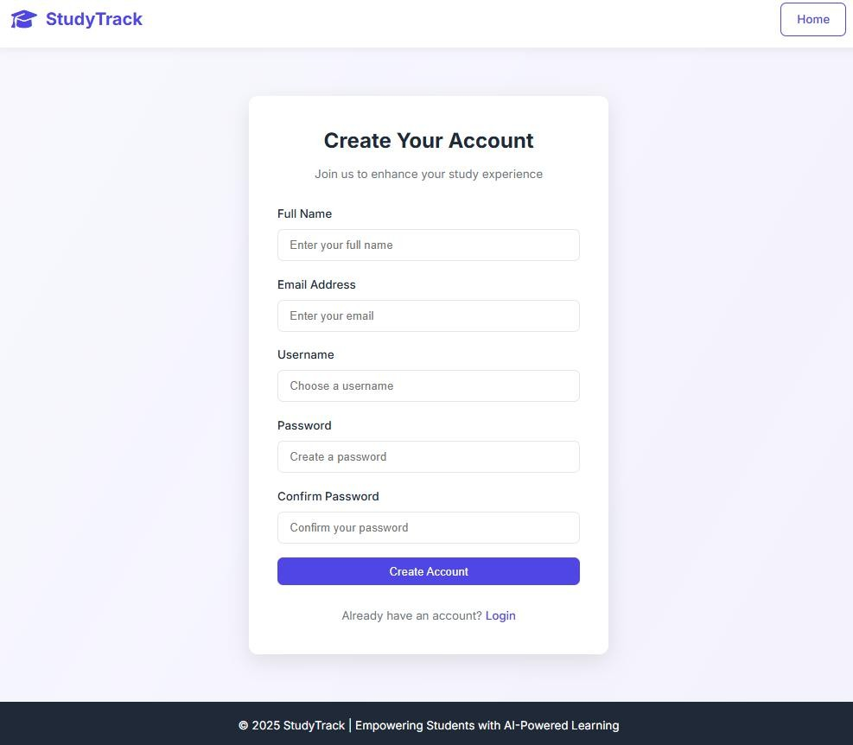

Registration Page

Slide 12




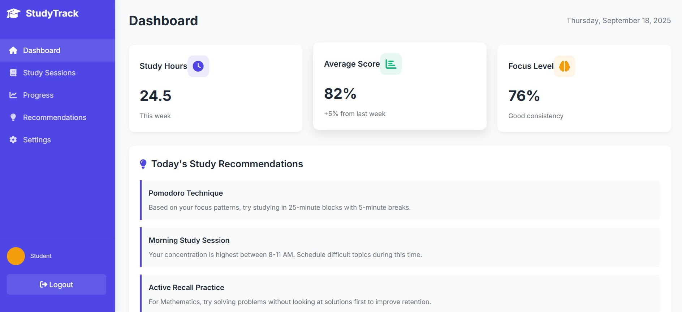

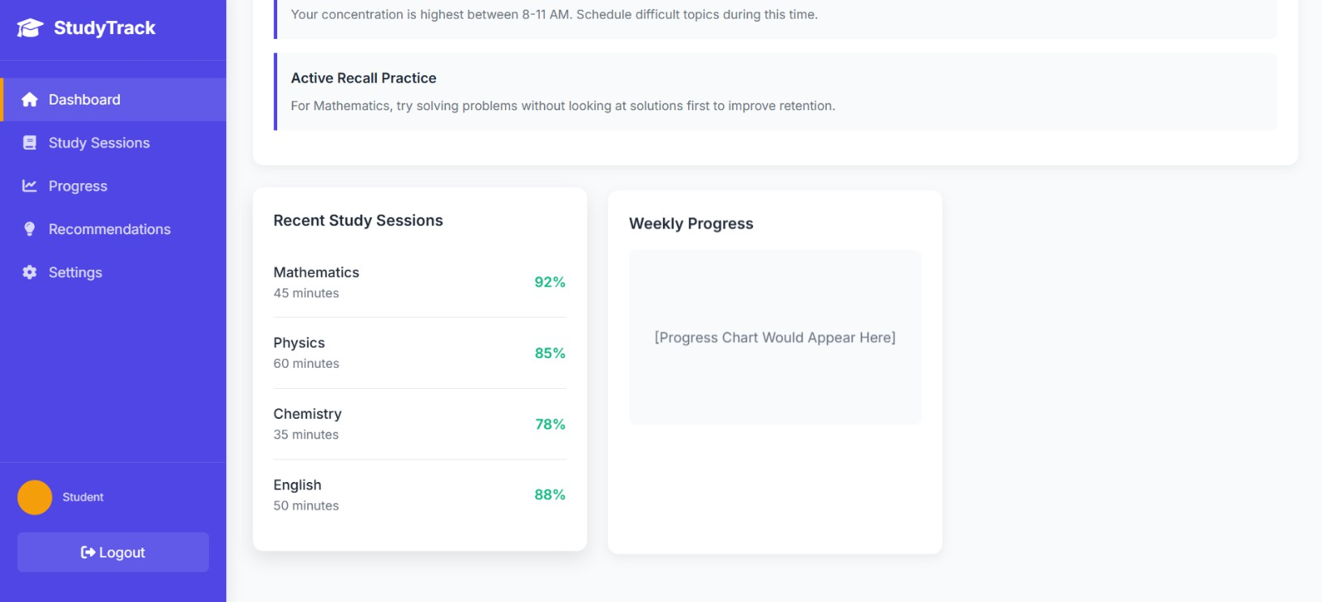



Dashboard
- John Doe

Slide 13

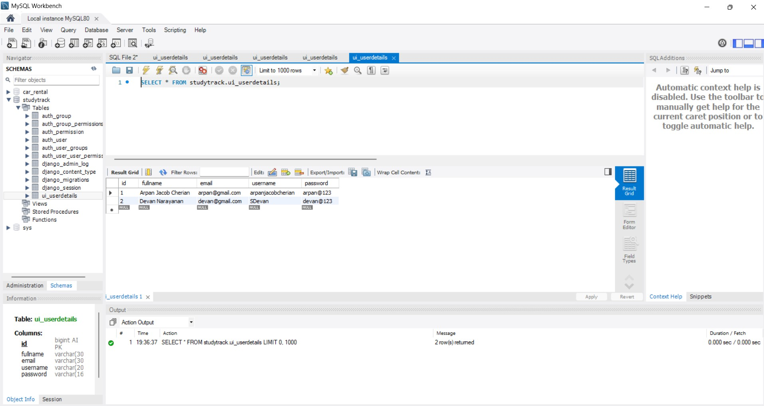
Database
- John Doe

Slide 14
MILESTONES 2
User Dashboard
View personalized dashboard with courses, study progress, and routine recommendations.
Access and track achievements via charts and progress reports.
Admin Dashboard
Database Enhancement
Manage students: add new entries, update student details, and view reports.
Admin dashboard for overseeing student records and database updates.
Add new student details table to store course info and behavioral data.
Improved schema for tracking recommendations and progress over time.

Slide 15
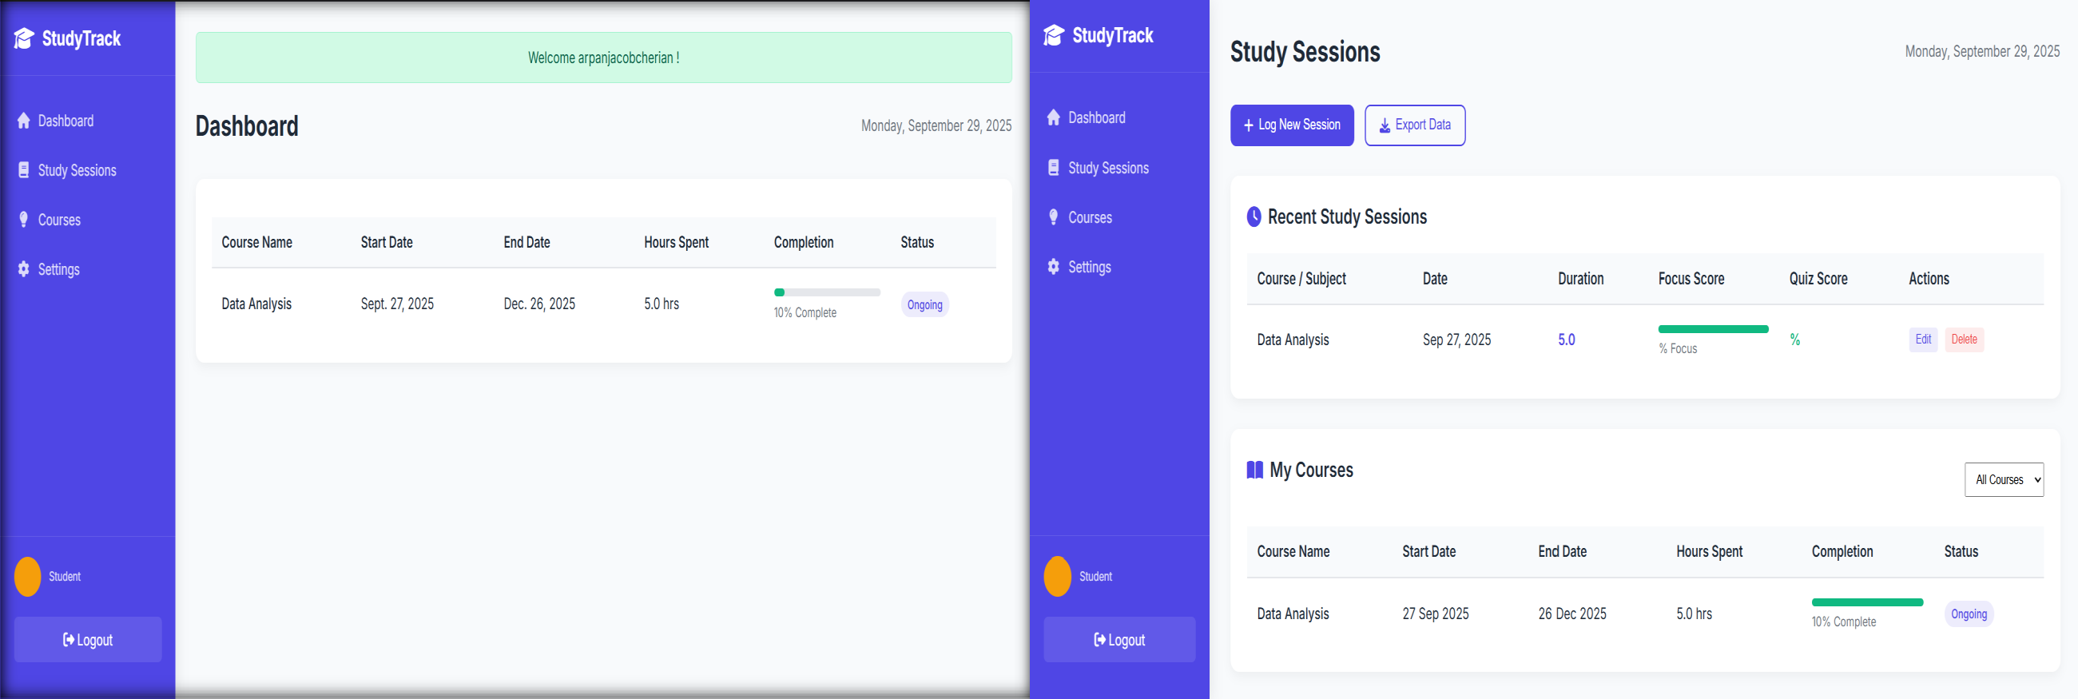


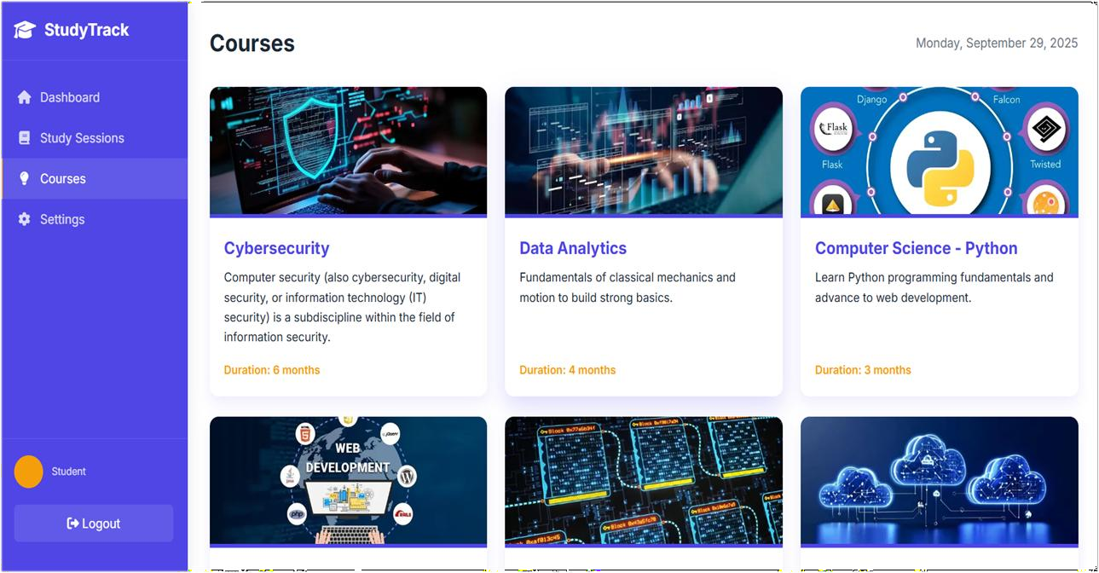
User Dashboard

Slide 16

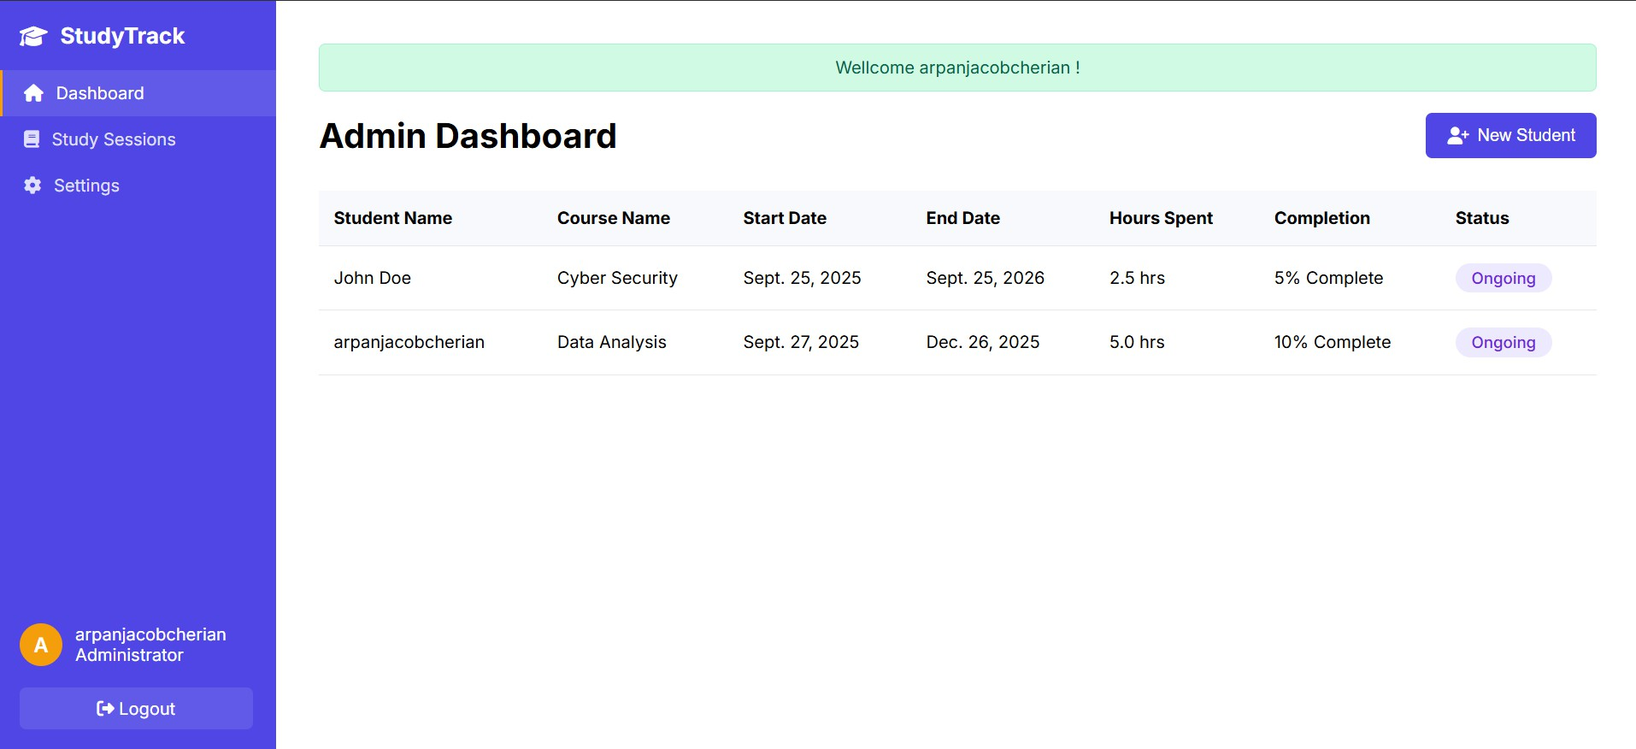
Admin Dashboard
- John Doe

Slide 17
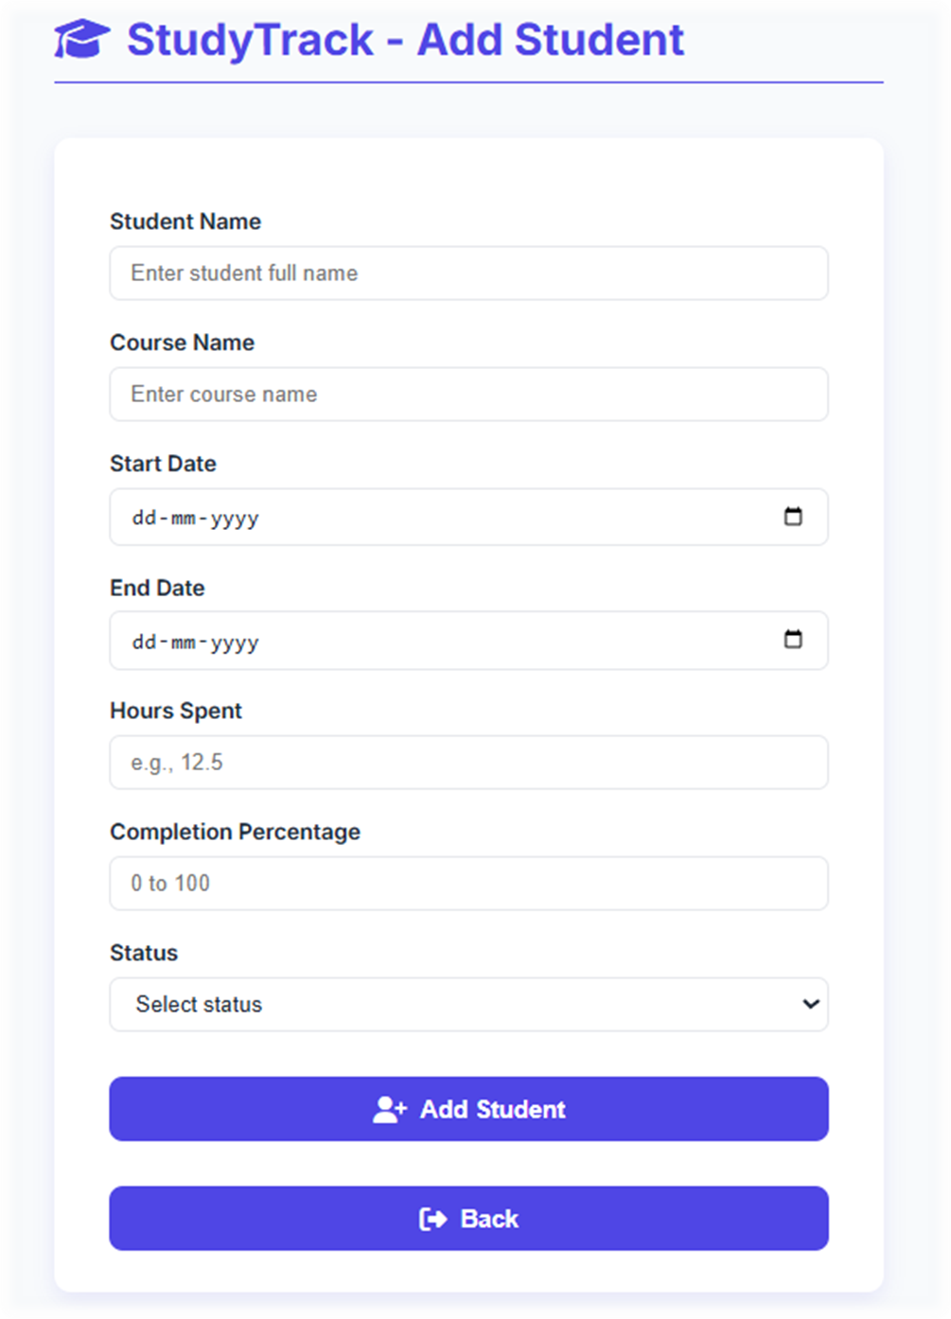

New Student

Slide 18
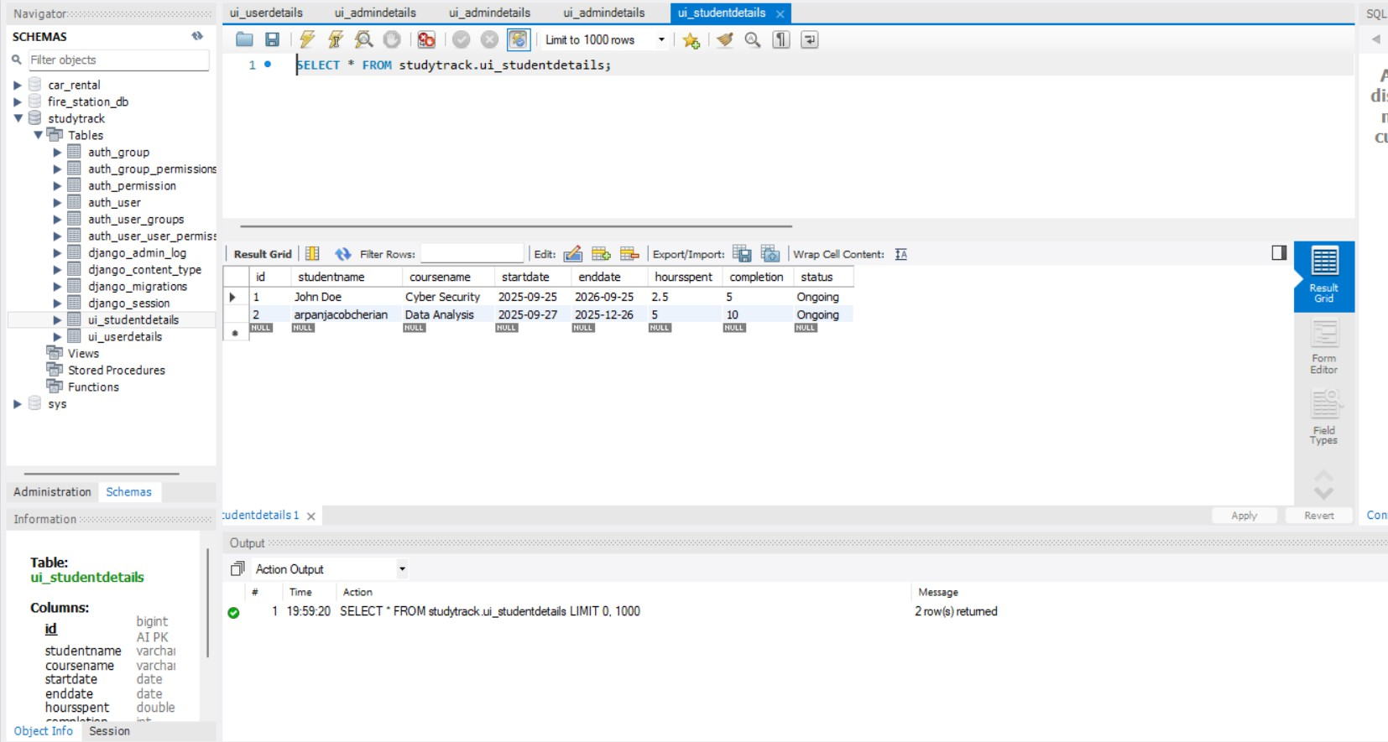
Database
- John Doe

Slide 19
MILESTONES 3
User Dashboard
The User Dashboard is now dynamic, fetching the list of assigned courses for the logged-in user directly from the database.
When an admin assigns a new course to a user, it immediately appears in that user's course list upon their next login or a page refresh.
Admin Dashboard
Database Enhancement
Enhanced the 'New Student' functionality to allow admins to assign a course when creating a new student record.
The dashboard now provides a unified view of all individual student-course enrollments and their real-time progress.
Updated the schema to create a direct link between users and their assigned courses.
Enables efficient loading of personalized course data on each user's dashboard.

Slide 20
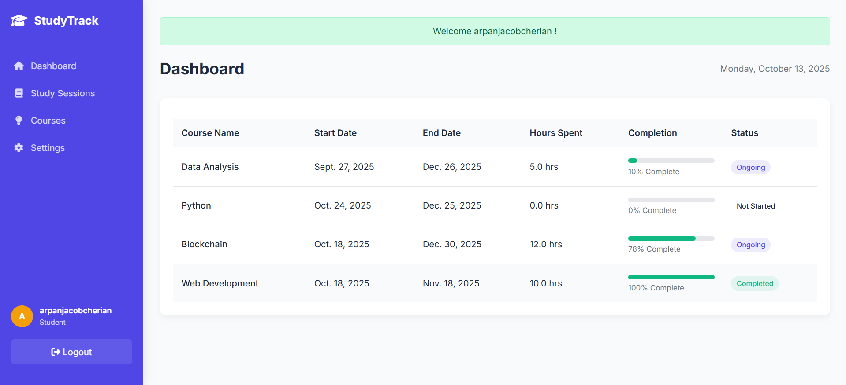
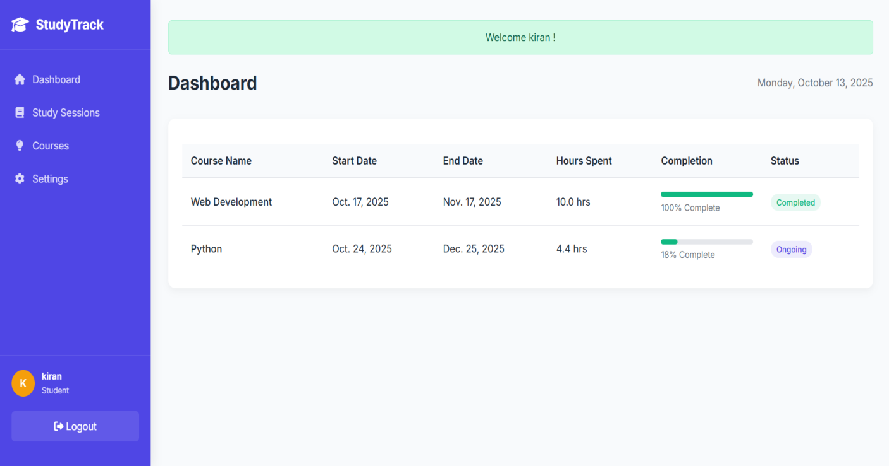
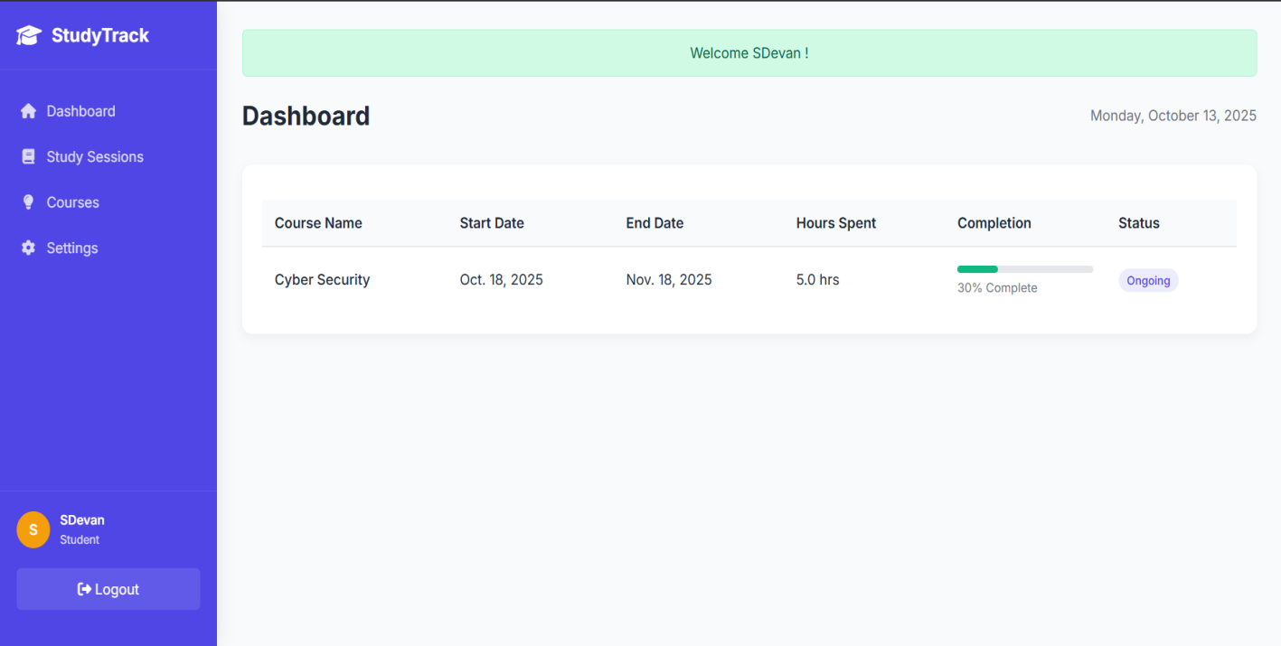
User Dashboard

Slide 21
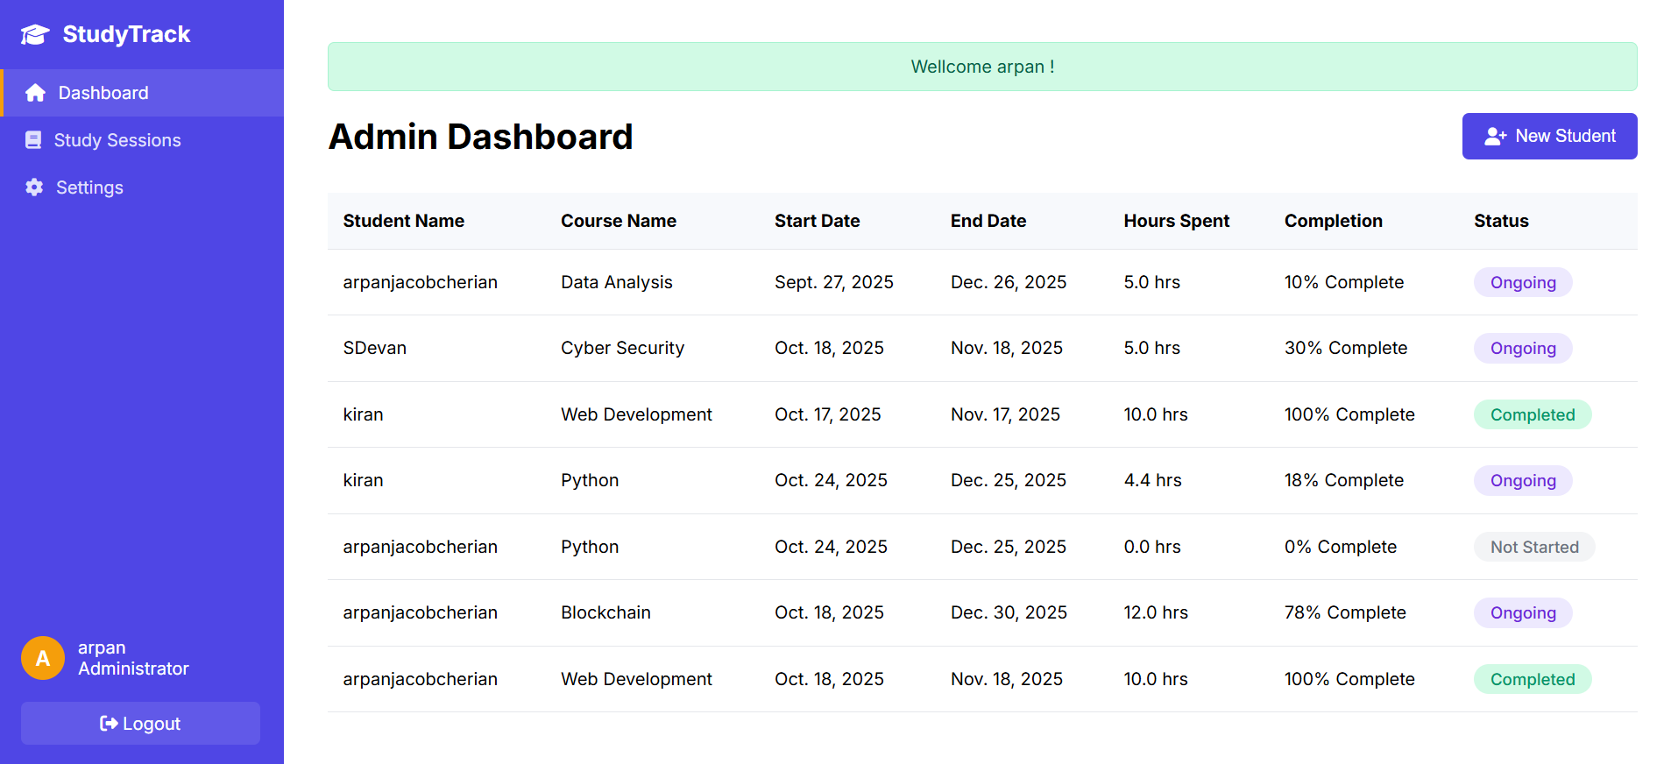
Admin Dashboard
- John Doe

Slide 22
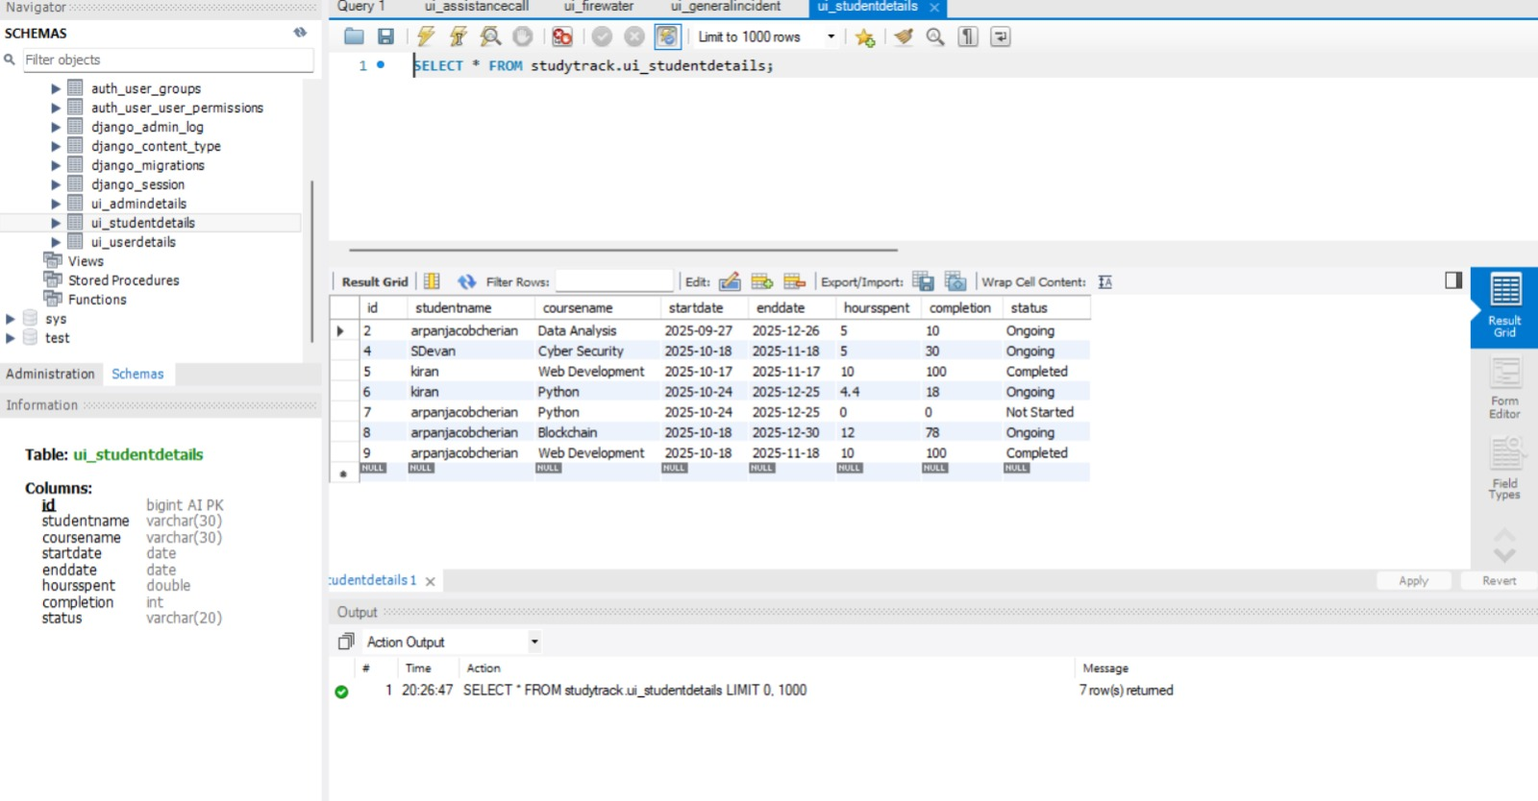
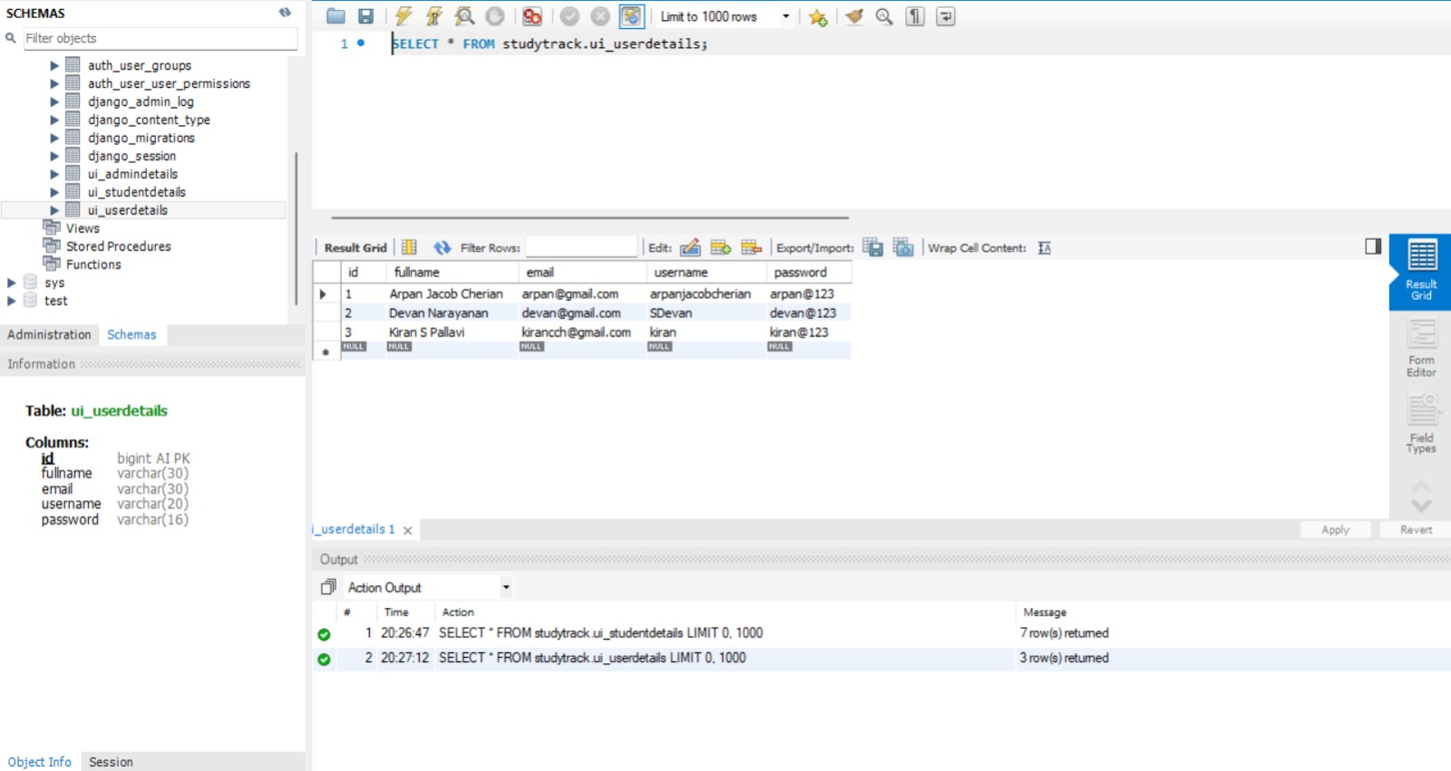
Databases

Slide 23
MILESTONES 4
AI Smart Dashboard
AI-powered dashboard shows personalized insights: strengths, weaknesses, and recommended study times.
Provides individual AI-based course recommendations to guide users.
Alert & Notification System
Database Enhancement
Automated email and in-app notifications for course progress and quiz reminders.
Dashboard alert highlights high-completion courses (over 75%) that need finishing.
Admins can now manually send email reminders to students.
New database tables added to manage courses, quizzes, notifications, and progress.
Full integration of the AI system to select and send notifications.

Slide 24
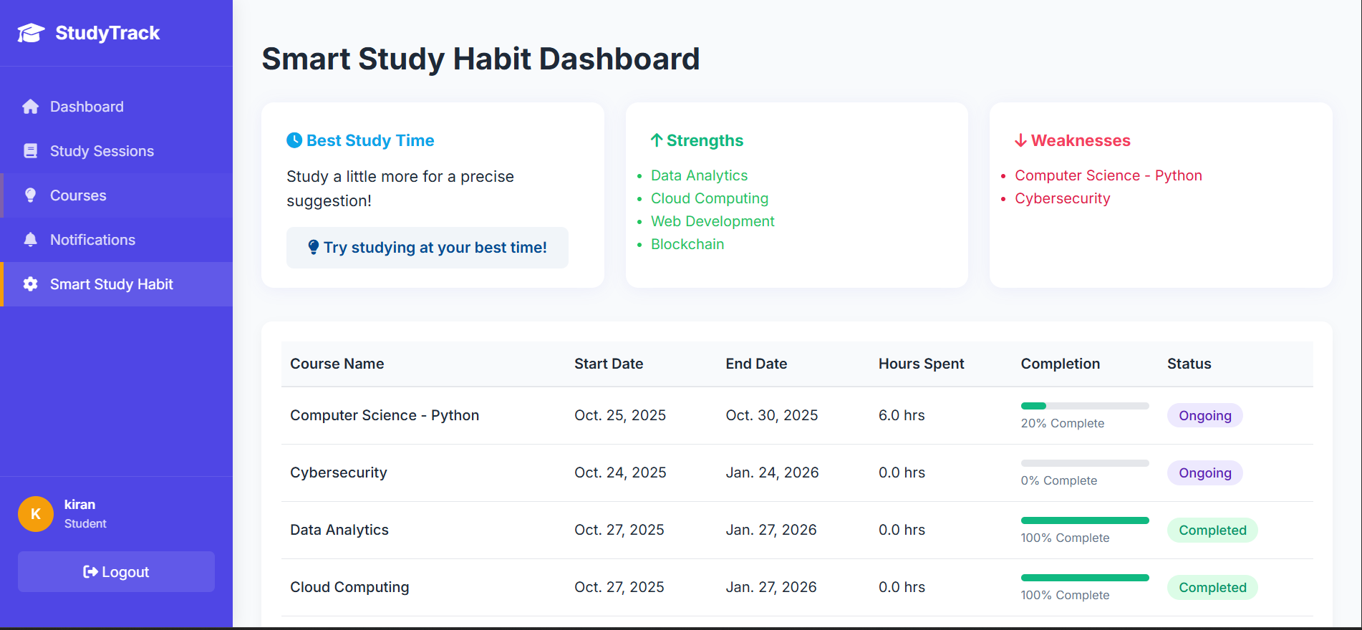
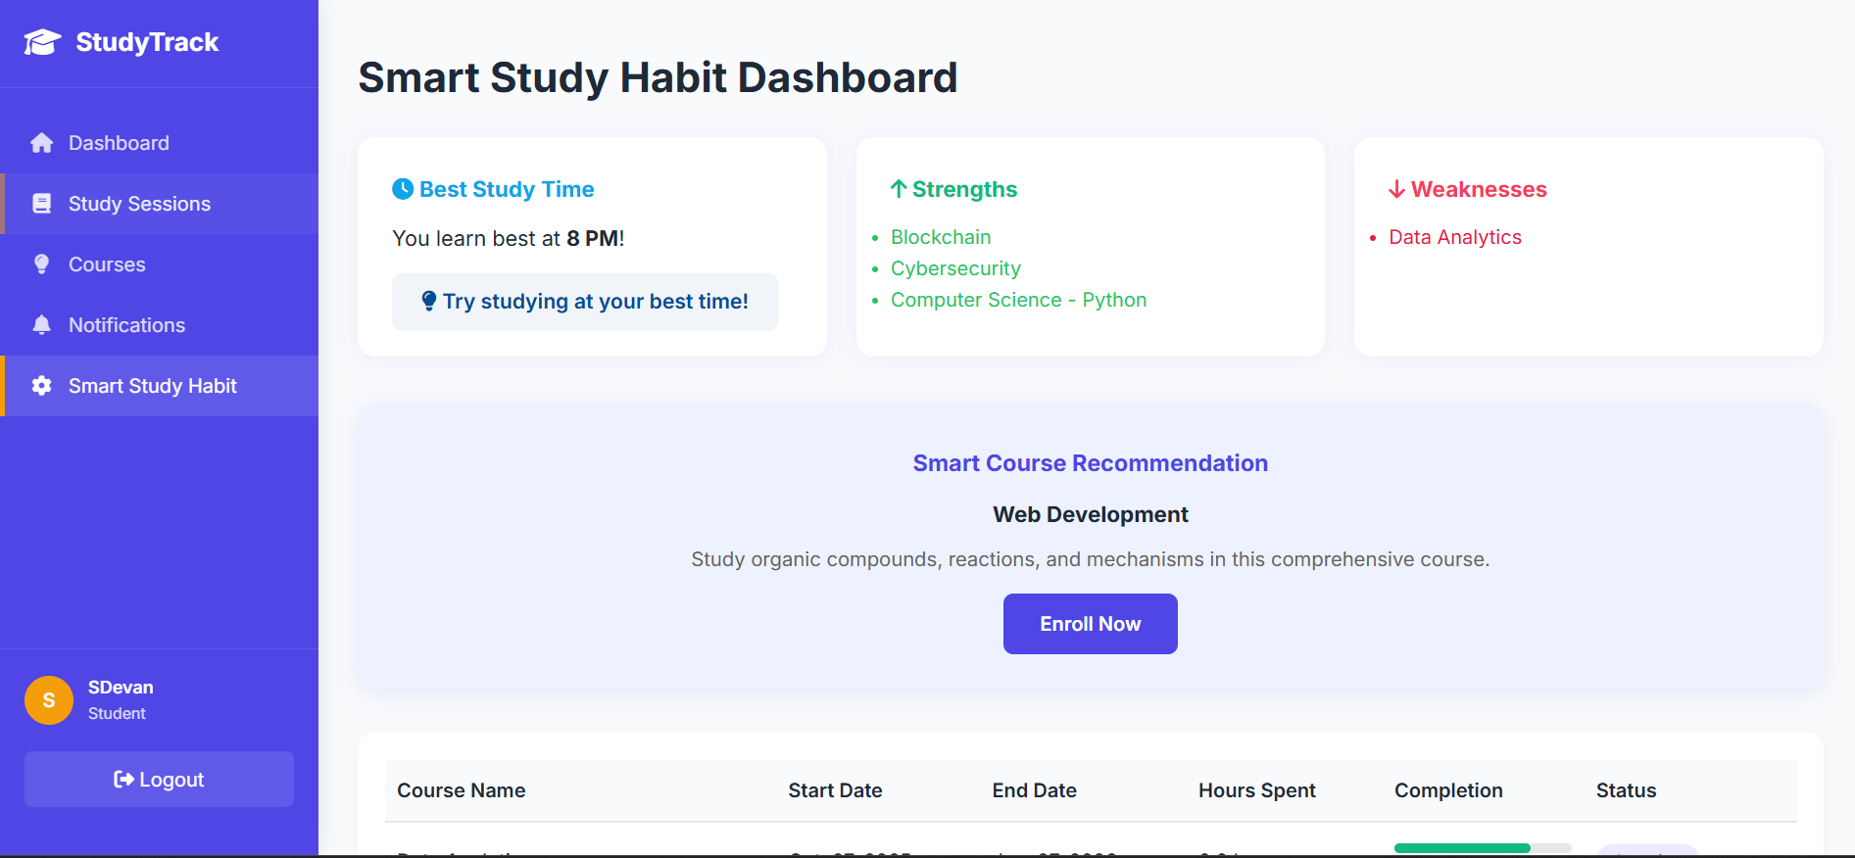
AI Smart Study Dashboard

Slide 25
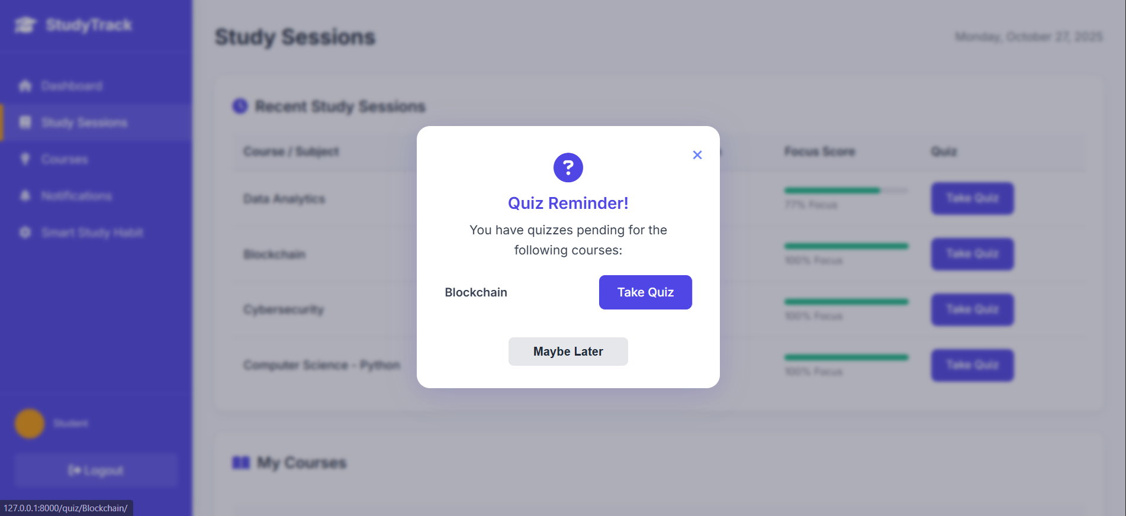
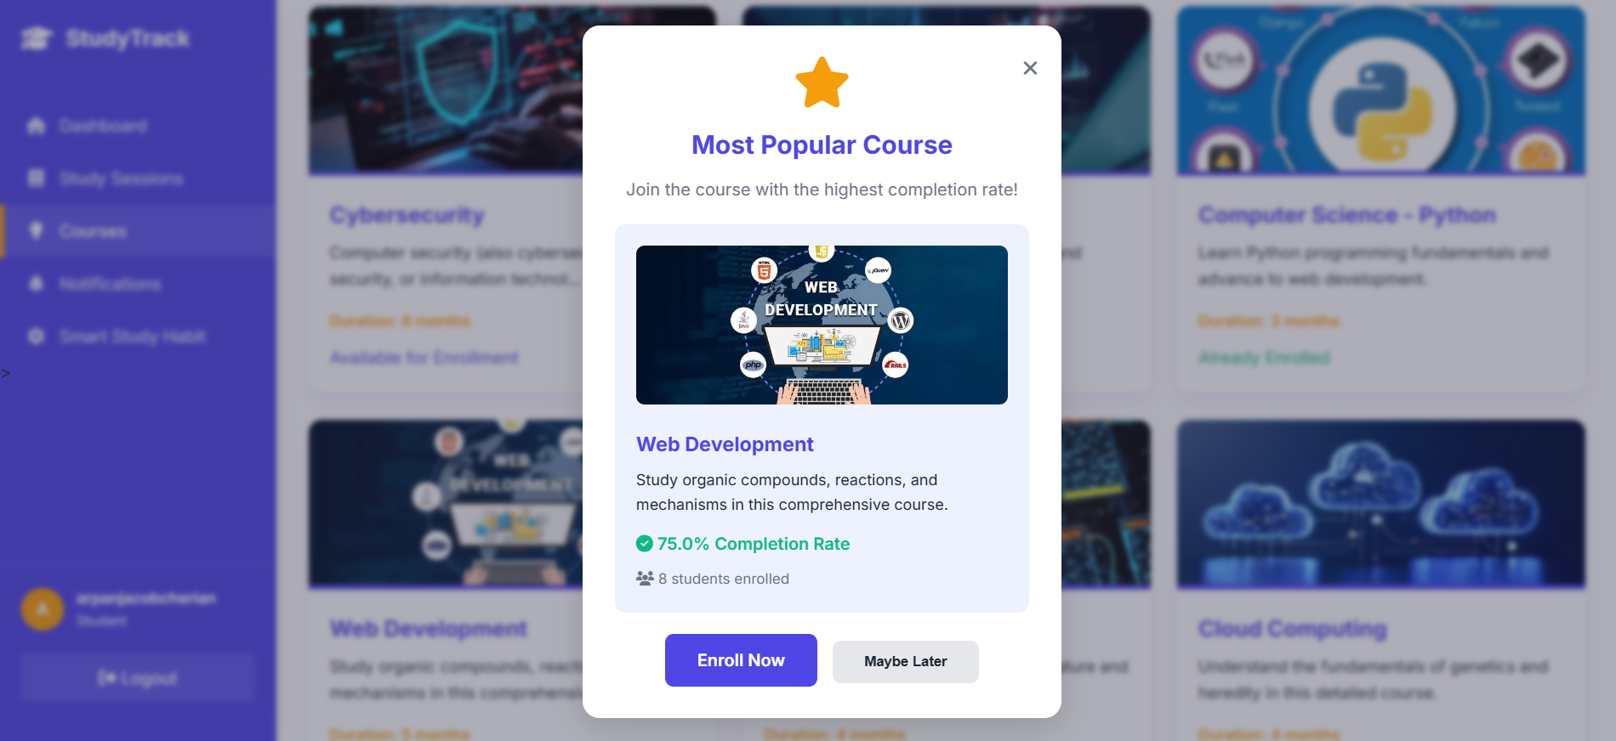
Notification and Alert System (Quiz and Most popular course)
- John Doe

Slide 26
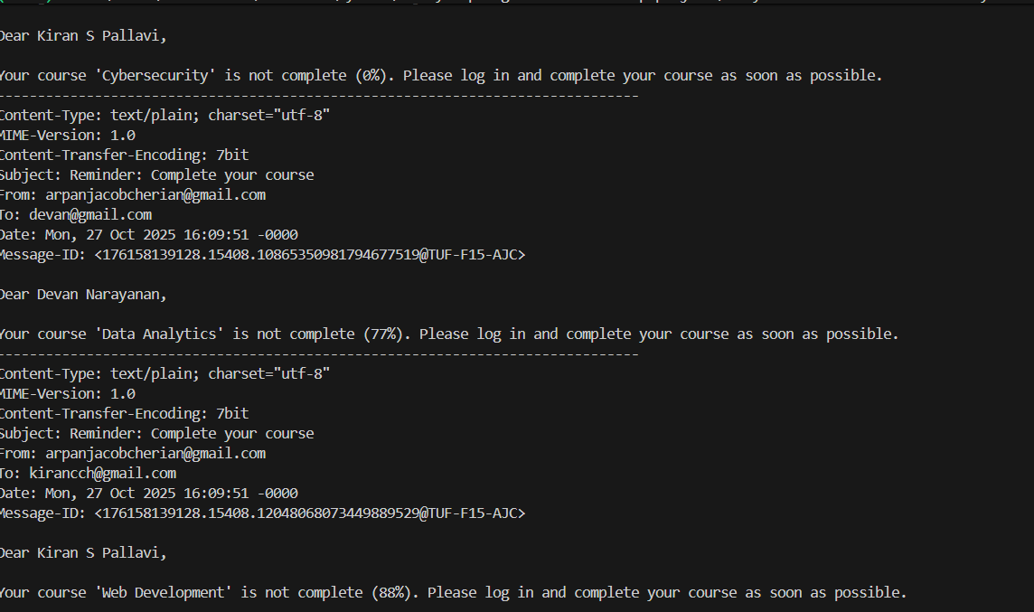
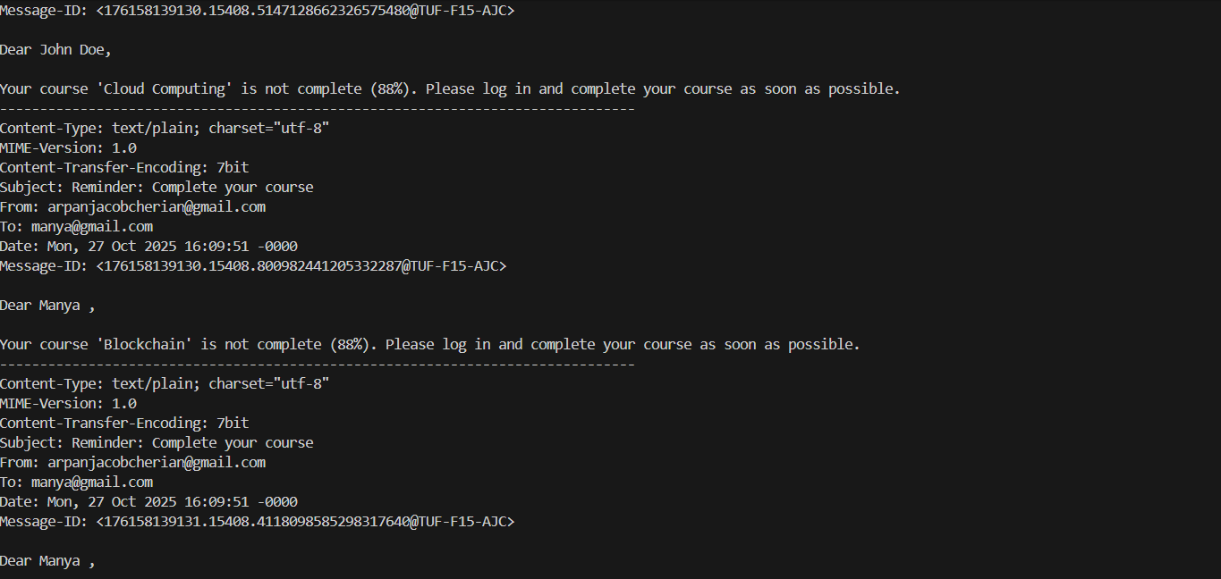
Notification and Alert System (Email alerts)
- John Doe

Slide 27
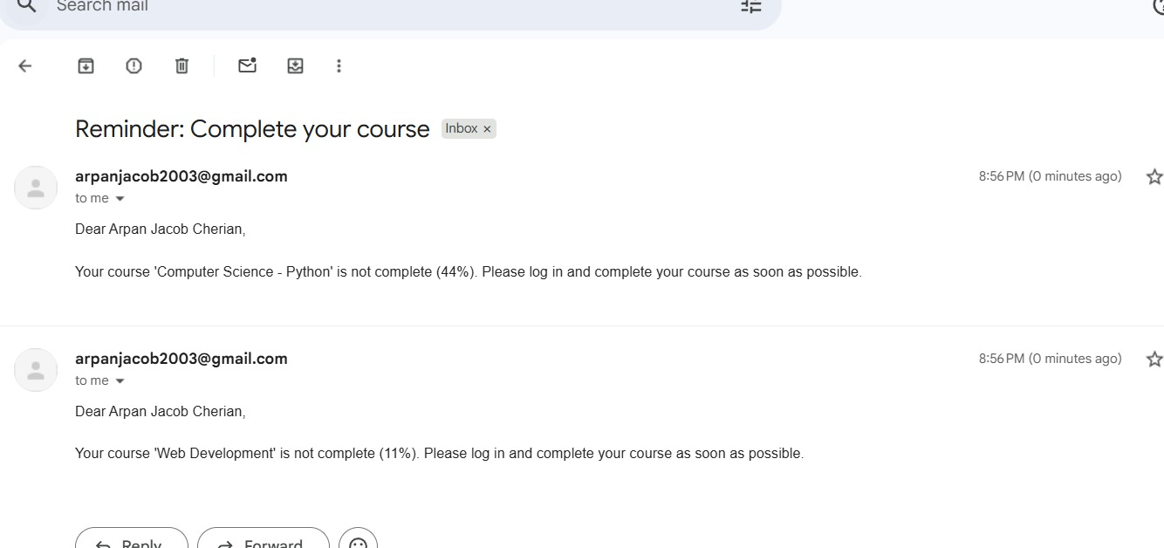
Notification and Alert System (Email alerts)

Slide 28
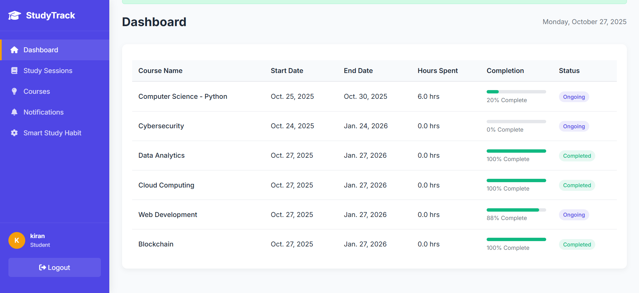
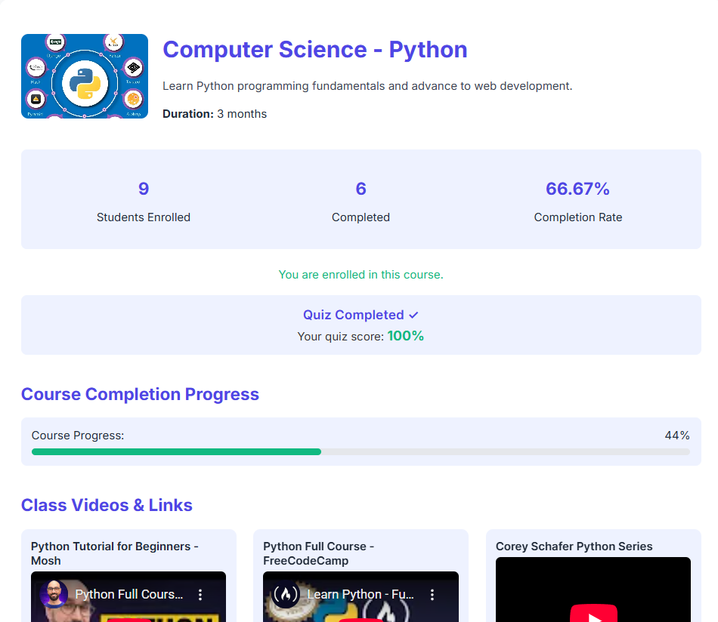
Enhanced course and Progress tracking
- John Doe

Slide 29
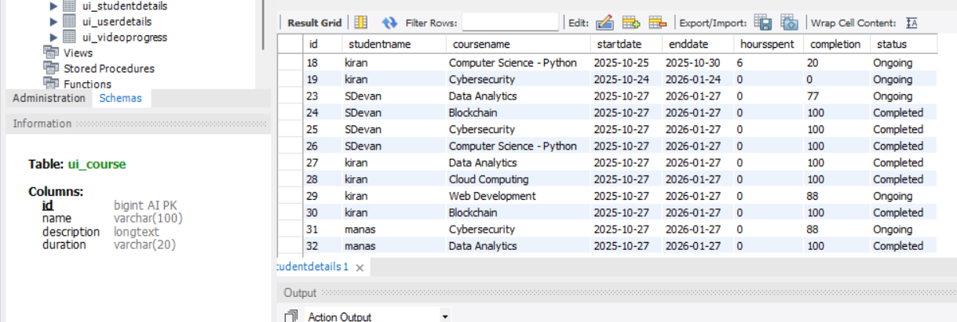
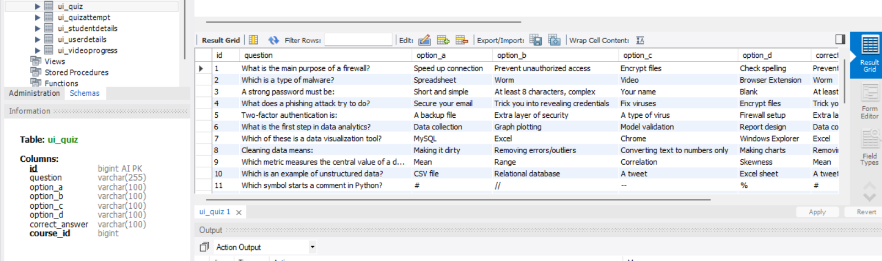
Databases (Course and Quiz)

Slide 30
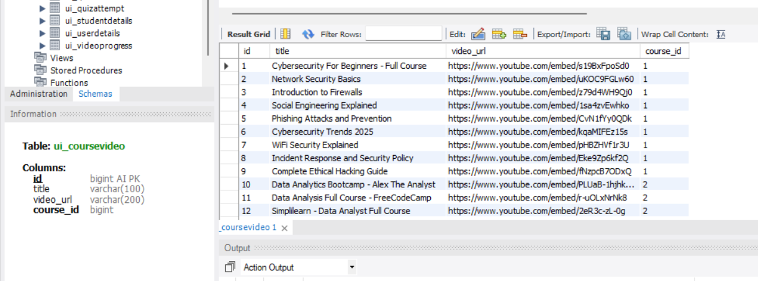
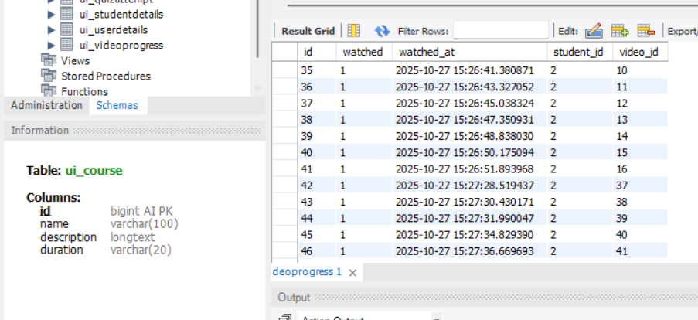
Databases (Course video and Video progress)

Slide 31


Conclusion
The StudyTrack project is a Python-Django system designed for personalized student progress tracking using machine learning. We began in Milestones 1 and 2 by building the foundation with secure registration, personalized user dashboards, and admin management tools. Milestone 3 made the system fully dynamic, enabling admins to assign courses that instantly appear on student dashboards. Finally, Milestone 4 transformed the application into an intelligent platform by integrating an AI-powered Smart Study Dashboard for personalized recommendations and a comprehensive notification system with both email and in-app alerts. With these milestones complete, StudyTrack is now a robust and intelligent tool that proactively guides students to enhance their academic performance.

Slide 32
Team Members
Arpan Jacob Cherian Manya
Mukesh Gangadhar

Slide 33
Thanks !

